Slide 1
April 13th
Abeta Clearance
Animal model APPTg2576
APP Trafficking

Slide 2
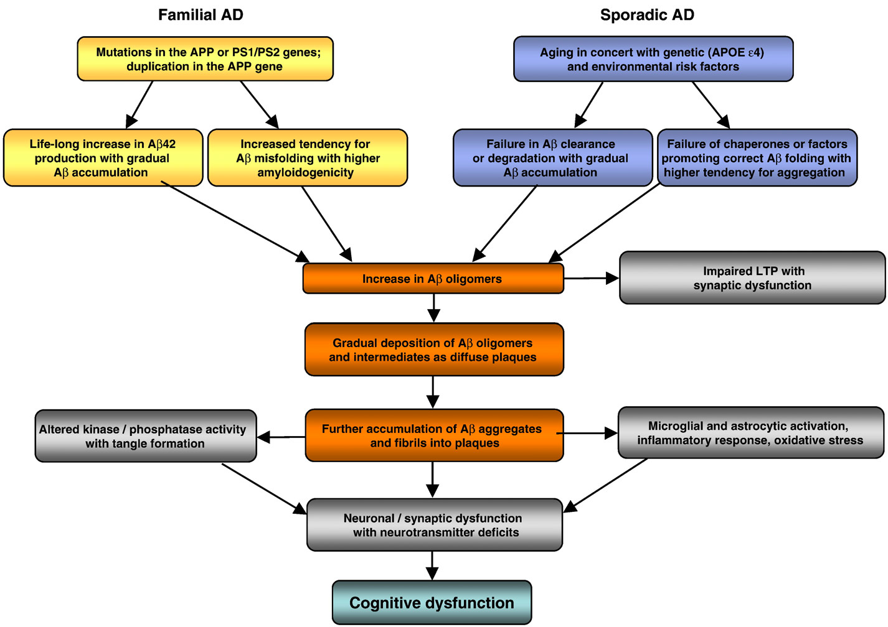
AD pathogenesis in familial and sporadic AD

Slide 3
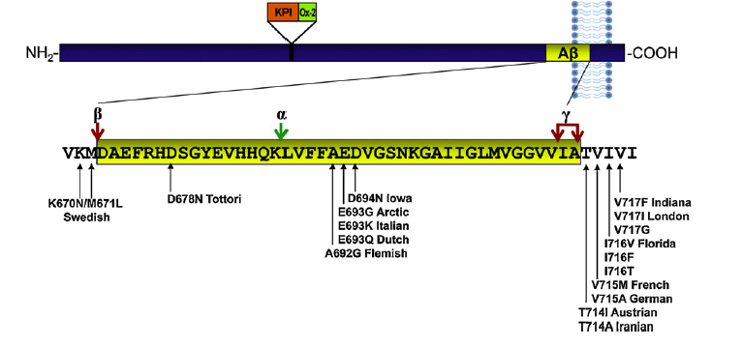
Map of APP mutations used to generate mutant AD mice

Slide 4
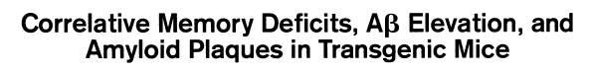
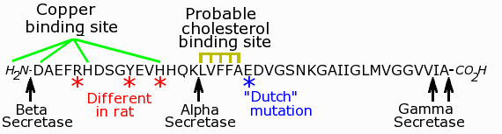
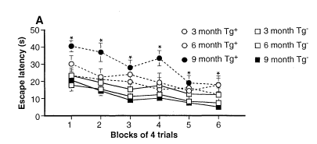
K670M/N671L
Swedish Mutation APPtg2576

Slide 5
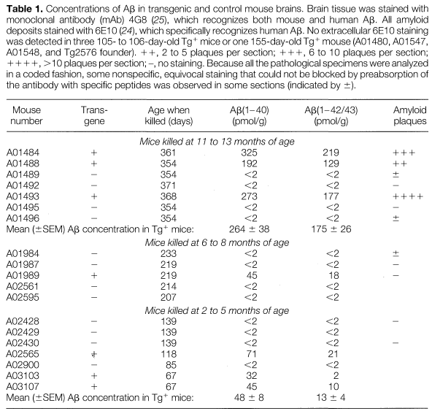
Abeta levels in the brain of APPtg2576
APPtg2576
control

Slide 6
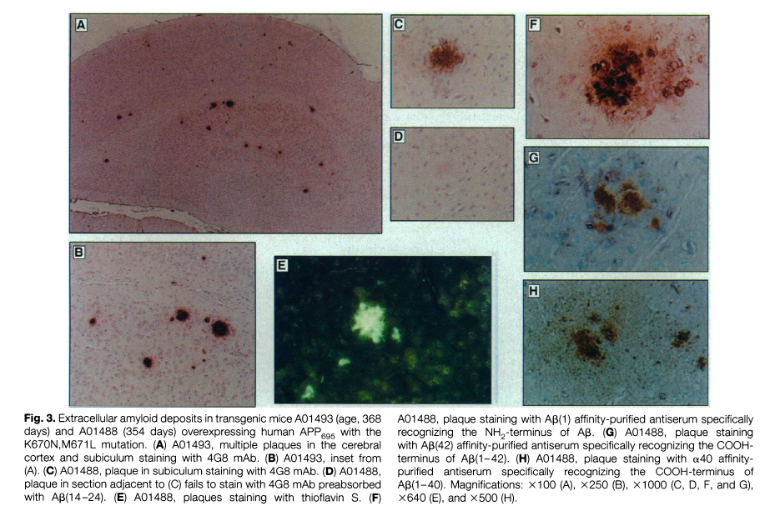
APPtg2576 is an animal model characterized by
beta-amyloid plaques deposition
N-term Ab
N-term Ab
1-42
C-term Ab
1-40

Slide 7
K670M/N671L
Swedish Mutation APPtg2576

Slide 8
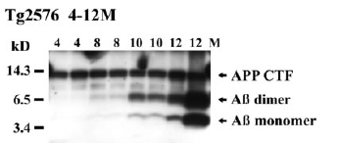
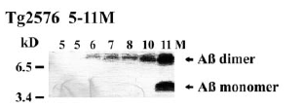
In APPtg2576 Abeta oligomers form and accumulate
before plaque pathology

Slide 9
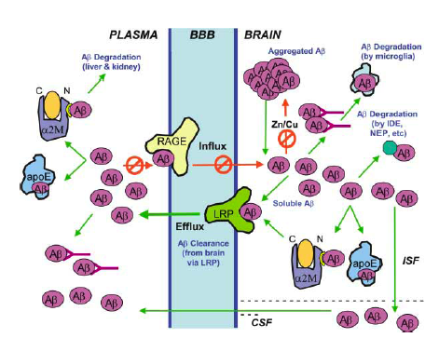
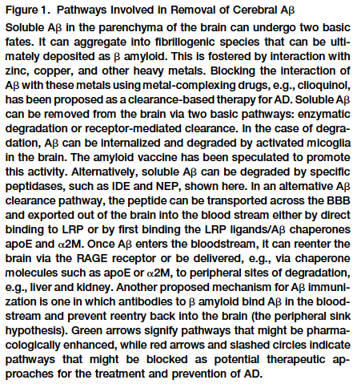
The many ways the system tries to get rid of the Abeta peptides

Slide 10
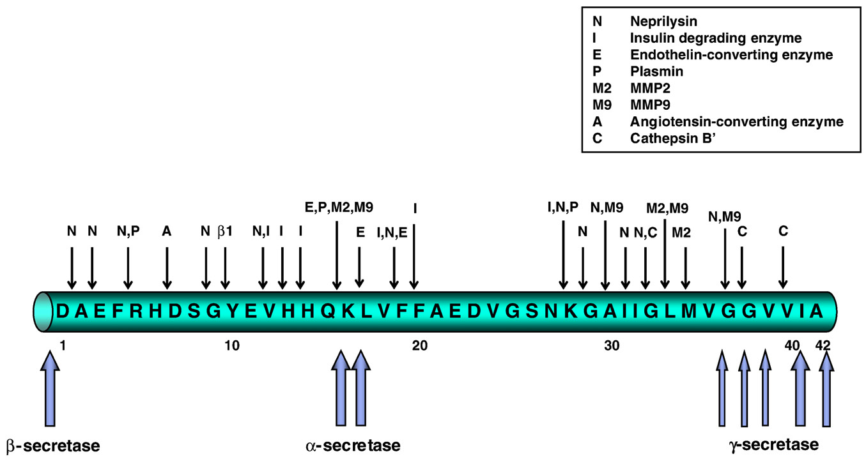
beta-Amyloid can be degraded at multiple sites

Slide 11
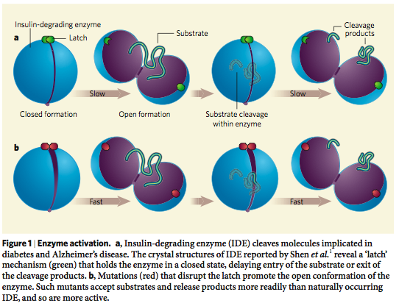
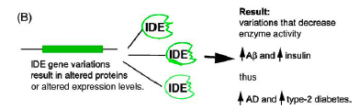
Insulin Degrading Enzyme (IDE) is crucial for Abeta degradation

Slide 12
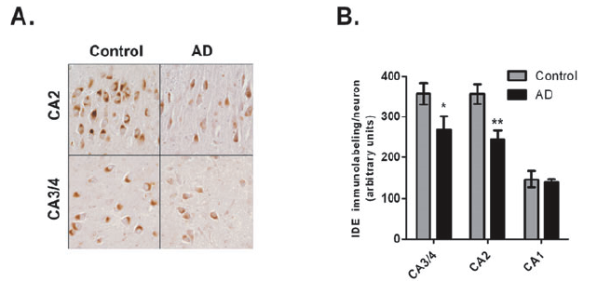
IDE levels are reduced in brain areas affected by AD

Slide 13
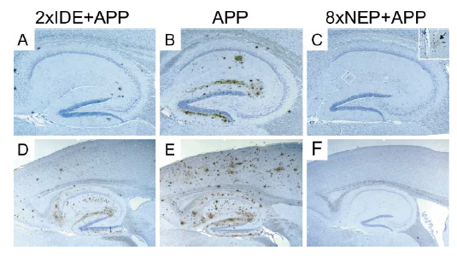
Decreased Aβ plaque burden in animals overexpressing
Insulin Degrading Enzyme (IDE) and Neprilysin
Leissring et al.,

Slide 14
Intracellular trafficking of APP: relation to its physiological function?

Slide 15
Processing of APP
α-secretase
β-secretase
APP
TMD
NH2
COOH
sαAPPs
C83
C99
sβAPPs
γ-secretase
γ-secretase
Aβ
AICD
p3
AICD
Protective
non-amyloidogenic
pathway
Pathogenic
amyloidogenic
pathway

Slide 16
APP retained @ plasma membrane =
Internalization of full length APP =
GOOD!!
☺
Protective non-amyloidogenic processing
BAD!!!
☹
pathogenic amyloidogenic processing

Slide 17
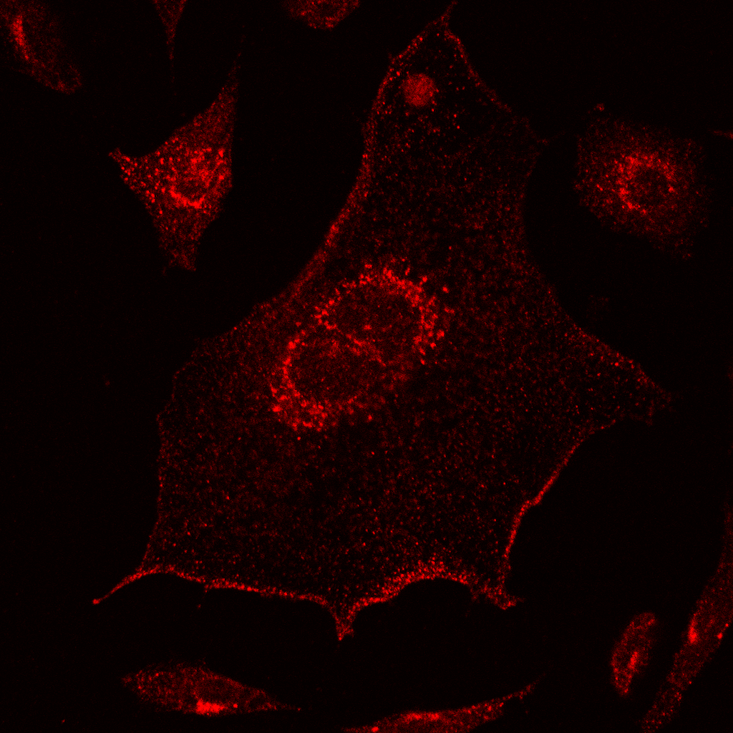
APP localizes to the plasma membrane, Golgi and endosomes
APP
TMD
5A3/1G7
NH₂
Pastorino, JAD 2012

Slide 18
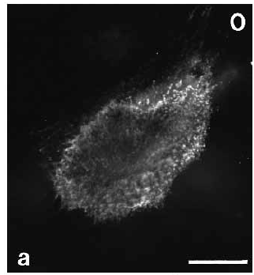
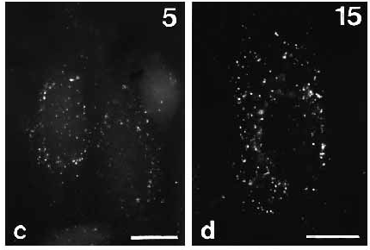
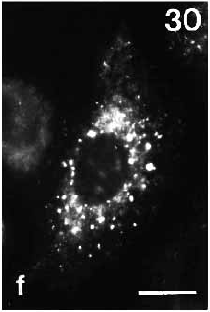
APP internalizes from the plasma membrane into intracellular compartments, endosomes and Golgi
APP
TMD
5A3/1G7
NH₂
COOH
Koo and Squazzo, 1994

Slide 19
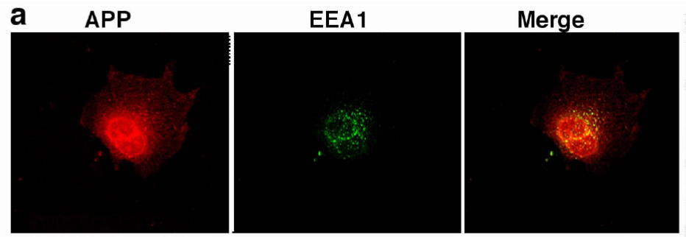
APP co-localizes with the endosomes
Pastorino et al., 2006

Slide 20
Products dowstream of non-amyloidogenic processing:
αAPPs: soluble stub of APP deriving from the α-secretase cleavage :
possible neurotrophic function
p3: c-terminal truncated portion of the sequence of b-amyloid, deriving from the subsequent action of α- and γ-secretase. DOES NOT aggregate. Unknown function.
AICD: APP Intra Cellular Domain, deriving from the cleavage of γ-secretase. Known regulation of transcriptional activity.

Slide 21
Products downstream of the amyloidogenic processing:
βAPPs: soluble stub of APP deriving from the β-secretase cleavage : unknown function
C99: c-terminal stub containing the entire intact sequence of the β-amyloid peptide, deriving from the action of β-secretase. It is the substrate from where β-amyloid peptides derive.
β-Amyloid peptides: generated by the subsequent action of β- and γ-secretases. At very low concentration could be neurotrophic, however, when forming aggregates they are VERY TOXIC and lead to the formation of the core of the β-amyloid plaque in AD
AICD: APP Intra Cellular Domain, deriving from the cleavage of γ-secretase. Known regulation of transcriptional activity.

